Slide 1
INPUT AND OUTPUT

Slide 2
Java provides streams as a general mechanism for dealing with data I/O.
A stream in Java is a path along which data flows.
A stream is an abstract representation of an input or output device that is a source of, or destination for, data.
We can write data to a stream and read data from a stream.
We can visualize a stream as a sequence of bytes that flows into or out of our program.

Slide 3
A stream is linked to a physical device by the java I/O system.
All streams behave in the same manner even if the actual physical devices to which they are linked differ.
Thus, the same I/O classes and methods can be applied to any type of device.

Slide 4
Source
Destination
Keyboard
Screen
Java program
Printer
Disk
Disk
Network
Network
Relationship of java program with I/O devices

Slide 5
An input stream is an object that an application can use to read a sequence of data .
An output stream is an object that an application can use to write a sequence of data.
An input stream acts as a source of data, and an output stream acts as a destination of data.

Slide 6
Input Stream
Reads
Program
Source
Reading data into a program
Output Stream
Program
Writes
Destination
Writing data to a destination

Slide 7
No matter where the data is coming from or going to and no matter what its type, the algorithms for sequentially reading and writing data are basically the same:
Reading | Writing
open a stream while more information read information close the stream | open a stream while more information write information close the stream

Slide 8
Stream Classes
The java.io package supports two types of stream, binary streams, which contain binary data, and character streams, which contain character data.
When we write data to a stream as a series of bytes, that is binary data.
Characters streams are used for storing and retrieving text.

Slide 9
Character Streams
Reader and Writer are the abstract superclasses for character streams in java.io.
Reader provides the API for readers--streams that read 16-bit characters.
Writer provides the API for writers--streams that write 16-bit characters.
Subclasses of Reader and Writer implement specialized streams and are divided into two categories: those that read from or write to data sinks (shown in gray in the following figures) and those that perform some sort of processing (shown in white).

Slide 10

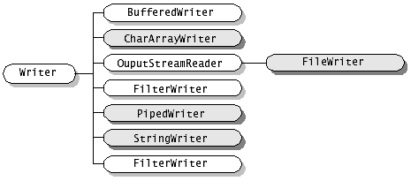

Slide 11
Byte Streams
To read and write 8-bit bytes, programs should use the byte streams.
InputStream and OutputStream provide the API for input streams (streams that read 8-bit bytes) and output streams (streams that write 8-bit bytes).
These streams are typically used to read and write binary data such as images and sounds.
Two of the byte stream classes, ObjectInputStream and ObjectOutputStream, are used for object serialization.
As with Reader and Writer, subclasses of InputStream and OutputStream provide specialized I/O that falls into two categories, as shown in the following class hierarchy figure: data sink streams (shaded) and processing streams (unshaded).

Slide 12
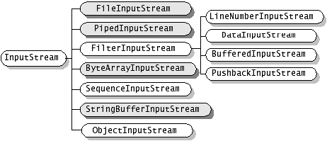
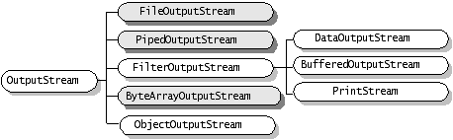

Slide 13
Reader and InputStream define similar APIs but for different data types.
Reader contains these methods for reading characters and arrays of characters:
int read()
Read a single character. It returns the character read, as an integer in the range 0 to 65535, or -1 if the end of the stream has been reached
int read(char[] cbuf)
Read characters into an array cbuf. It returns the number of characters read, or -1 if the end of the stream has been reached
int read(char[] cbuf, int m, int n)
Read n characters into cbuff array starting from mth character.

Slide 14
InputStream defines the same methods but for reading bytes and arrays of bytes:
int read ()
Reads the next byte of data from the input stream. The value byte is returned as an int in the range 0 to 255. the value -1 is returned if the end of the stream has been reached.
int read (byte[] b)
Reads up to b.length bytes of data from this input stream into an array(b) of bytes.
int read (byte[] b, int m, int n)
Read n bytes from the input stream into the array b starting from mth byte.

Slide 15
Writer and OutputStream are similarly parallel.
Writer defines these methods for writing characters and arrays of characters:
void write (int c)
Write a single character.
void write (char[] cbuf)
Write an array of characters.
void write (char[] cbuf, int off, int len)
Write a portion of an array of characters.

Slide 16
OutputStream defines the same methods but for bytes:
void write (int b)
Writes the specified byte to this output stream.
void write (byte[] b)
Writes b.length bytes from the specified byte array to this output stream.
void write (byte[] b, int off, int len)
Writes len bytes from the specified byte array starting at offset off to this output stream.

Slide 17
All of the streams--readers, writers, input streams, and output streams--are automatically opened when created.
You can close any stream explicitly by calling its close method. Or the garbage collector can implicitly close it, which occurs when the object is no longer referenced.

Slide 18
Reading and Writing Files
ShowFile.java
Output:
D:\JAVA>java ShowFile c:\first.txt
dyregistrar@iiseindia.com
D:\JAVA>

Slide 19
CopyFile.java
OUTPUT:
D:\JAVA>java CopyFile c:\first.txt d:\second.txt
D:\JAVA>java ShowFile d:\second.txt
dyregistrar@iiseindia.com
D:\JAVA>

Slide 20
File
The File class does not specify how information is retrieved from or stored in files; it describes the properties of the file itself.
A File object is used to obtain or manipulate the information associated with a disk file, such as the permissions, time , date and directory path, and to navigate subdirectory hierarchies.

Slide 21
The following constructors can be used to create File objects :
File(String directoryPath)
File(String directoryPath, String filename)
File(File dirObj, String filename)
Here, directoryPath is the path name of the file, filename is the name of the file and dirObj is a File object that specifies a directory.

Slide 22
File f1 = new File(“/”);
File f2 = new File(“/”,”autoexec.bat”);
File f3 = new File(f1,”autoexec.bat”);
The above example creates three files: f1,f2 and f3.
The first File object is constructed with a directory path as the only argument.
The second includes two arguments- the path and the filename.
The third includes the file path assigned to f1 and a filename; f3 refers to the same file as f2.

Slide 23
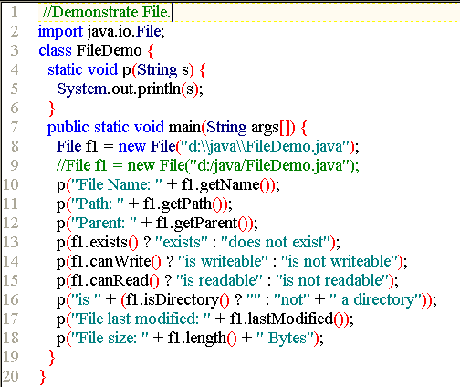

Slide 24
Output:
File Name: FileDemo.java
Path: d:\java\FileDemo.java
Parent: d:\java
exists
is writeable
is readable
is not a directory
File last modified: 1113963270000
File size: 722 Bytes
Press any key to continue . . .

Slide 25
Directories
A directory is a file that contains a list of other files and directories.
When we create a File object and it is a directory, the isDirectory() method will return true.
The list() method on that object can be used to extract other files and directories inside it.

Slide 26
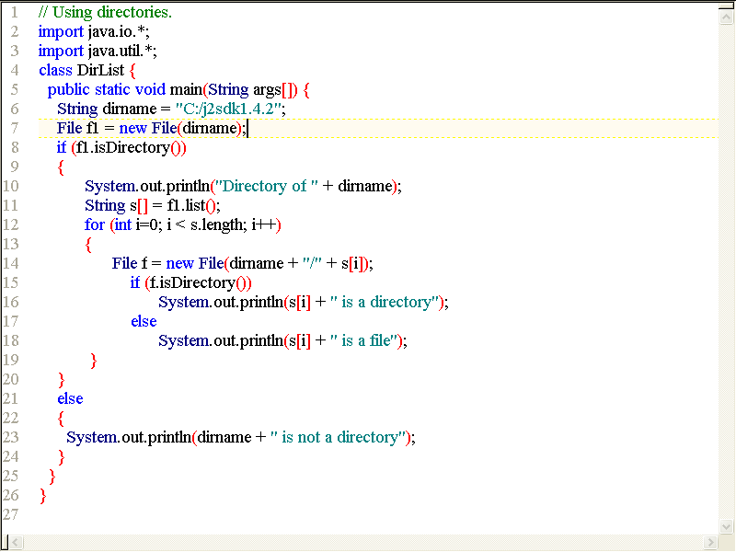

Slide 27
Output:
Directory of C:/j2sdk1.4.2
COPYRIGHT is a file
LICENSE is a file
LICENSE.rtf is a file
README.html is a file
README.txt is a file
THIRDPARTYLICENSEREADME.txt is a file
bin is a directory
include is a directory
jre is a directory
lib is a directory
demo is a directory
src.zip is a file
Press any key to continue . . .

